Slide 1
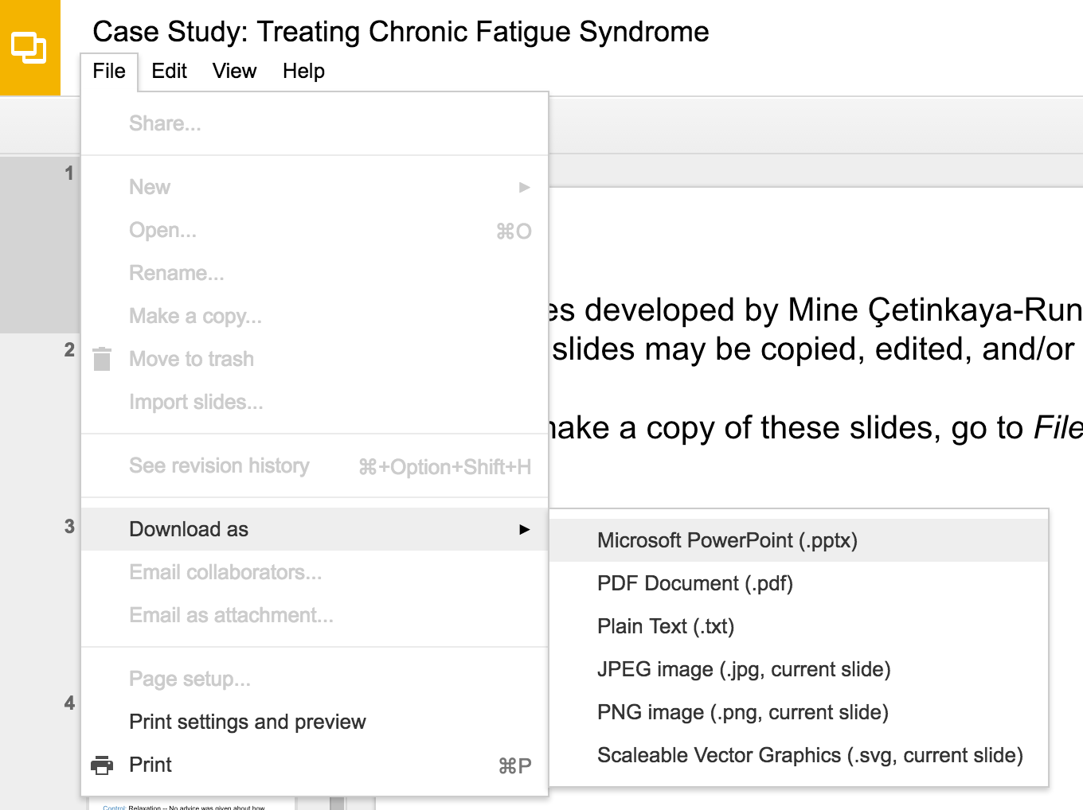
Slides developed by Mine Çetinkaya-Rundel of OpenIntro
Translated from LaTeX to Google Slides by Curry W. Hilton of OpenIntro.
The slides may be copied, edited, and/or shared via the CC BY-SA license
To make a copy of these slides, go to File > Download as > [option], as shown below. Or if you are logged into a Google account, you can choose Make a copy... to create your own version in Google Drive.

Slide 2
Inference for
Linear Regression

Slide 3
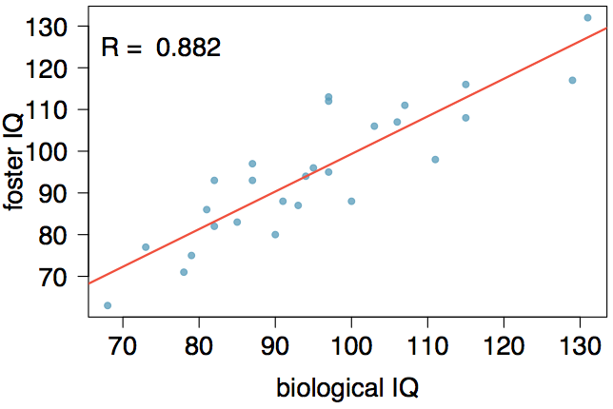
Nature or nurture?
In 1966 Cyril Burt published a paper called "The genetic determination of differences in intelligence: A study of monozygotic twins reared apart?" The data consist of IQ scores for [an assumed random sample of] 27 identical twins, one raised by foster parents, the other by the biological parents.

Slide 4

Practice
Which of the following is false?
Coefficients:
Estimate Std. Error t value Pr(>|t|)
(Intercept) 9.20760 9.29990 0.990 0.332
bioIQ 0.90144 0.09633 9.358 1.2e-09
Residual standard error: 7.729 on 25 degrees of freedom
Multiple R-squared: 0.7779, Adjusted R-squared: 0.769
F-statistic: 87.56 on 1 and 25 DF, p-value: 1.204e-09
Additional 10 points in the biological twin's IQ is associated with additional 9 points in the foster twin's IQ, on average.
Roughly 78% of the foster twins' IQs can be accurately predicted by the model.
The linear model is
Foster twins with IQs higher than average IQs tend to have biological twins with higher than average IQs as well.

Slide 5
Practice
Which of the following is false?
Coefficients:
Estimate Std. Error t value Pr(>|t|)
(Intercept) 9.20760 9.29990 0.990 0.332
bioIQ 0.90144 0.09633 9.358 1.2e-09
Residual standard error: 7.729 on 25 degrees of freedom
Multiple R-squared: 0.7779, Adjusted R-squared: 0.769
F-statistic: 87.56 on 1 and 25 DF, p-value: 1.204e-09
Additional 10 points in the biological twin's IQ is associated with additional 9 points in the foster twin's IQ, on average.
Roughly 78% of the foster twins' IQs can be accurately predicted by the model.
The linear model is
Foster twins with IQs higher than average IQs tend to have biological twins with higher than average IQs as well.

Slide 6
Testing for the slope
Assuming that these 27 twins comprise a representative sample of all twins separated at birth, we would like to test if these data provide convincing evidence that the IQ of the biological twin is a significant predictor of IQ of the foster twin. What are the appropriate hypotheses?
H₀: b₀ = 0; H_{A}: b₀ ≠ 0
H₀: β₀ = 0; H_{A}: β₀ ≠ 0
H₀: b₁ = 0; H_{A}: b₁ ≠ 0
H₀: β₁ = 0; H_{A}: β₁ ≠ 0

Slide 7
Testing for the slope
Assuming that these 27 twins comprise a representative sample of all twins separated at birth, we would like to test if these data provide convincing evidence that the IQ of the biological twin is a significant predictor of IQ of the foster twin. What are the appropriate hypotheses?
H₀: b₀ = 0; H_{A}: b₀ ≠ 0
H₀: β₀ = 0; H_{A}: β₀ ≠ 0
H₀: b₁ = 0; H_{A}: b₁ ≠ 0
H₀: β₁ = 0; H_{A}: β₁ ≠ 0

Slide 8
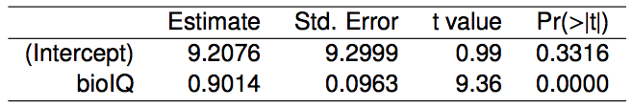
Testing for the slope (cont.)

Slide 9
Testing for the slope (cont.)
We always use a t-test in inference for regression.

Slide 10
Testing for the slope (cont.)
We always use a t-test in inference for regression.
Remember: test statistic T = (point estimate - null value) / SE

Slide 11
Testing for the slope (cont.)
We always use a t-test in inference for regression.
Remember: test statistic T = (point estimate - null value) / SE
Point estimate = b₁ is the observed slope.

Slide 12
Testing for the slope (cont.)
We always use a t-test in inference for regression.
Remember: test statistic T = (point estimate - null value) / SE
Point estimate = b₁ is the observed slope.
SE_{b1} is the standard error associated with the slope.

Slide 13
Testing for the slope (cont.)
We always use a t-test in inference for regression.
Remember: test statistic T = (point estimate - null value) / SE
Point estimate = b₁ is the observed slope.
SE_{b1} is the standard error associated with the slope.
Degrees of freedom associated with the slope is df = n - 2, where n is the sample size.

Slide 14
Testing for the slope (cont.)
We always use a t-test in inference for regression.
Remember: test statistic T = (point estimate - null value) / SE
Point estimate = b₁ is the observed slope.
SE_{b1} is the standard error associated with the slope.
Degrees of freedom associated with the slope is df = n - 2, where n is the sample size.
Remember: we lose 1 degree of freedom for each parameter we estimate, and in simple linear regression we estimate 2 parameters, β₀ and β₁.

Slide 15
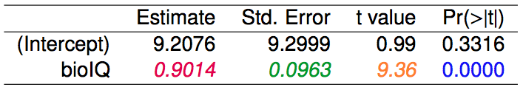
Testing for the slope (cont.)

Slide 16

Testing for the slope (cont.)

Slide 17
Testing for the slope (cont.)

Slide 18

Testing for the slope (cont.)

Slide 19
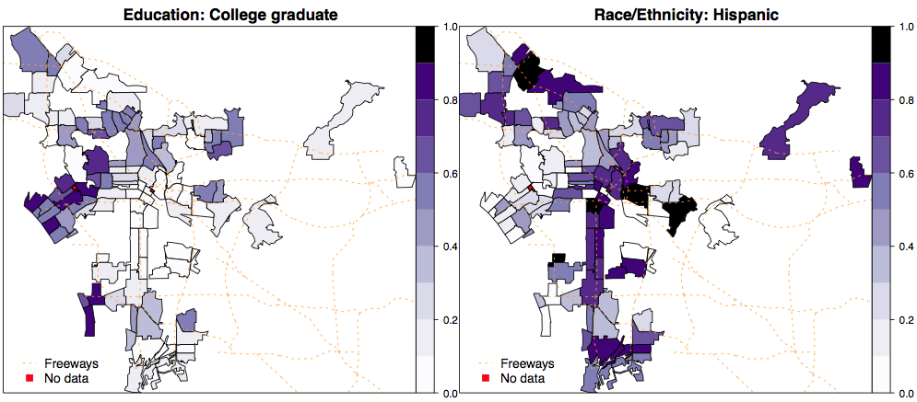
Percent college graduate vs. percent Hispanic in LA
What can you say about the relationship between % college graduate and % Hispanic in a sample of 100 zip code areas in LA?

Slide 20
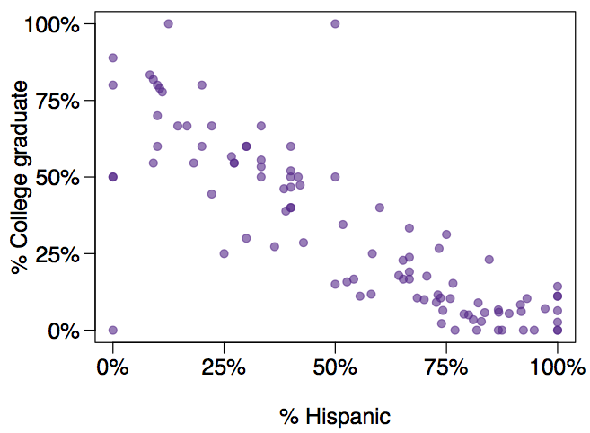
% college educated vs. % Hispanic in LA, another look
What can you say about the relationship between of % college graduate and % Hispanic in a sample of 100 zip code areas in LA?

Slide 21
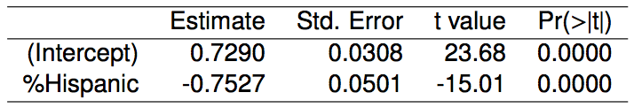
% college educated vs. % Hispanic in LA - linear model
Which of the below is the best interpretation of the slope?
A 1% increase in Hispanic residents in a zip code area in LA is associated with a 75% decrease in % of college grads.
A 1% increase in Hispanic residents in a zip code area in LA is associated with a 0.75% decrease in % of college grads.
An additional 1% of Hispanic residents decreases the % of college graduates in a zip code area in LA by 0.75%.
In zip code areas with no Hispanic residents, % of college graduates is expected to be 75%.

Slide 22
% college educated vs. % Hispanic in LA - linear model
Which of the below is the best interpretation of the slope?
A 1% increase in Hispanic residents in a zip code area in LA is associated with a 75% decrease in % of college grads.
A 1% increase in Hispanic residents in a zip code area in LA is associated with a 0.75% decrease in % of college grads.
An additional 1% of Hispanic residents decreases the % of college graduates in a zip code area in LA by 0.75%.
In zip code areas with no Hispanic residents, % of college graduates is expected to be 75%.

Slide 23
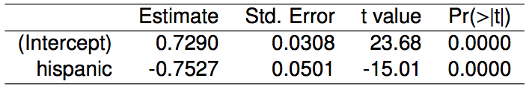
% college educated vs. % Hispanic in LA - linear model
Do these data provide convincing evidence that there is a statistically significant relationship between % Hispanic and % college graduates in zip code areas in LA?
How reliable is this p-value if these zip code areas are not randomly selected?

Slide 24
% college educated vs. % Hispanic in LA - linear model
Do these data provide convincing evidence that there is a statistically significant relationship between % Hispanic and % college graduates in zip code areas in LA?
Yes, the p-value for % Hispanic is low, indicating that the data provide convincing evidence that the slope parameter is different than 0.
How reliable is this p-value if these zip code areas are not randomly selected?

Slide 25
% college educated vs. % Hispanic in LA - linear model
Do these data provide convincing evidence that there is a statistically significant relationship between % Hispanic and % college graduates in zip code areas in LA?
Yes, the p-value for % Hispanic is low, indicating that the data provide convincing evidence that the slope parameter is different than 0.
How reliable is this p-value if these zip code areas are not randomly selected?
Not very...

Slide 26
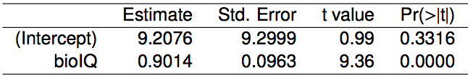
Confidence interval for the slope
Remember that a confidence interval is calculated as point estimate ± ME and the degrees of freedom associated with the slope in a simple linear regression is n - 2. Which of the below is the correct 95% confidence interval for the slope parameter? Note that the model is based on observations from 27 twins.
9.2076 ± 1.65 x 9.2999
0.9014 ± 2.06 x 0.0963
0.9014 ± 1.96 x 0.0963
9.2076 ± 1.96 x 0.0963

Slide 27
Confidence interval for the slope
Remember that a confidence interval is calculated as point estimate ± ME and the degrees of freedom associated with the slope in a simple linear regression is n - 2. Which of the below is the correct 95% confidence interval for the slope parameter? Note that the model is based on observations from 27 twins.
n = 27 df = 27 - 2 = 25
9.2076 ± 1.65 x 9.2999
0.9014 ± 2.06 x 0.0963
0.9014 ± 1.96 x 0.0963
9.2076 ± 1.96 x 0.0963

Slide 28
Confidence interval for the slope
Remember that a confidence interval is calculated as point estimate ± ME and the degrees of freedom associated with the slope in a simple linear regression is n - 2. Which of the below is the correct 95% confidence interval for the slope parameter? Note that the model is based on observations from 27 twins.
n = 27 df = 27 - 2 = 25
9.2076 ± 1.65 x 9.2999
0.9014 ± 2.06 x 0.0963
0.9014 ± 1.96 x 0.0963
9.2076 ± 1.96 x 0.0963
95%: t₂₅* = 2.06

Slide 29
Confidence interval for the slope
Remember that a confidence interval is calculated as point estimate ± ME and the degrees of freedom associated with the slope in a simple linear regression is n - 2. Which of the below is the correct 95% confidence interval for the slope parameter? Note that the model is based on observations from 27 twins.
n = 27 df = 27 - 2 = 25
9.2076 ± 1.65 x 9.2999
0.9014 ± 2.06 x 0.0963
0.9014 ± 1.96 x 0.0963
9.2076 ± 1.96 x 0.0963
95%: t₂₅* = 2.06
0.9014 ± 2.06 x 0.0963

Slide 30
Confidence interval for the slope
Remember that a confidence interval is calculated as point estimate ± ME and the degrees of freedom associated with the slope in a simple linear regression is n - 2. Which of the below is the correct 95% confidence interval for the slope parameter? Note that the model is based on observations from 27 twins.
n = 27 df = 27 - 2 = 25
9.2076 ± 1.65 x 9.2999
0.9014 ± 2.06 x 0.0963
0.9014 ± 1.96 x 0.0963
9.2076 ± 1.96 x 0.0963
95%: t₂₅* = 2.06
0.9014 ± 2.06 x 0.0963
(0.7, 1.1)

Slide 31
Recap
Inference for the slope for a single-predictor linear regression model:

Slide 32

Recap
Inference for the slope for a single-predictor linear regression model:
Hypothesis test:

Slide 33

Recap
Inference for the slope for a single-predictor linear regression model:
Hypothesis test:
Confidence interval:

Slide 34
Recap
Inference for the slope for a single-predictor linear regression model:
Hypothesis test:
Confidence interval:
The null value is often 0 since we are usually checking for any relationship between the explanatory and the response variable.

Slide 35
Recap
Inference for the slope for a single-predictor linear regression model:
Hypothesis test:
Confidence interval:
The null value is often 0 since we are usually checking for any relationship between the explanatory and the response variable.
The regression output gives b₁, SE_{b1}, and two-tailed p-value for the t-test for the slope where the null value is 0.

Slide 36
Recap
Inference for the slope for a single-predictor linear regression model:
Hypothesis test:
Confidence interval:
The null value is often 0 since we are usually checking for any relationship between the explanatory and the response variable.
The regression output gives b₁, SE_{b1}, and two-tailed p-value for the t-test for the slope where the null value is 0.
We rarely do inference on the intercept, so we'll be focusing on the estimates and inference for the slope.

Slide 37
Caution
Always be aware of the type of data you're working with: random sample, non-random sample, or population.

Slide 38
Caution
Always be aware of the type of data you're working with: random sample, non-random sample, or population.
Statistical inference, and the resulting p-values, are meaningless when you already have population data.

Slide 39
Caution
Always be aware of the type of data you're working with: random sample, non-random sample, or population.
Statistical inference, and the resulting p-values, are meaningless when you already have population data.
If you have a sample that is non-random (biased), inference on the results will be unreliable.

Slide 40
Caution
Always be aware of the type of data you're working with: random sample, non-random sample, or population.
Statistical inference, and the resulting p-values, are meaningless when you already have population data.
If you have a sample that is non-random (biased), inference on the results will be unreliable.
The ultimate goal is to have independent observations.

Slide 41
Find more resources at openintro.org/os, including
Slides
Videos
Statistical Software Labs
Discussion Forums (free support for students and teachers)
Learning Objectives
Teachers only content is also available for Verified Teachers, including
Exercise solutions
Sample exams
Ability to request a free desk copy for a course
Statistics Teachers email group
Questions? Contact us.

Slide 42
Extra Slides from the OS3 section on inference for linear regression

